Slide 1
OSG brand
Water Ionizer
Taiyo Bussan Co., Ltd
2024.9.27

Slide 2
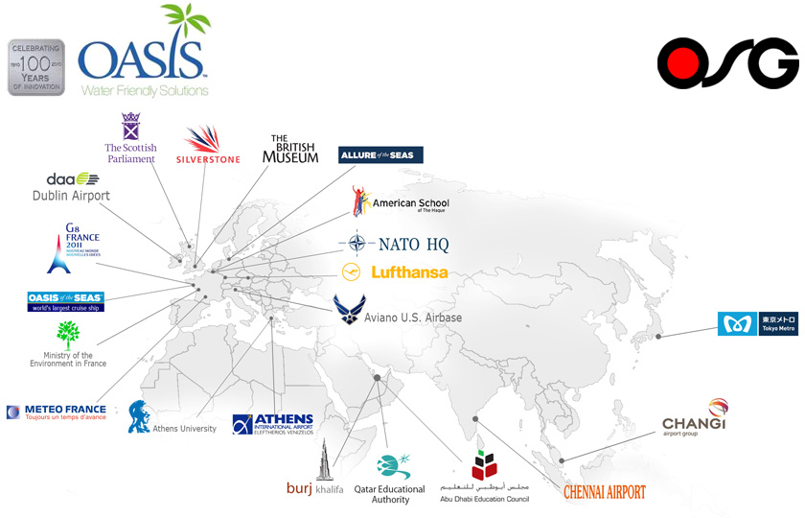
OSG Corporation
OSG Corporation has been developing and selling products related to “Health & Environment” for over 50 years globally.
They keep contributing towards making lives safer, more secured and hygienic.

Slide 3
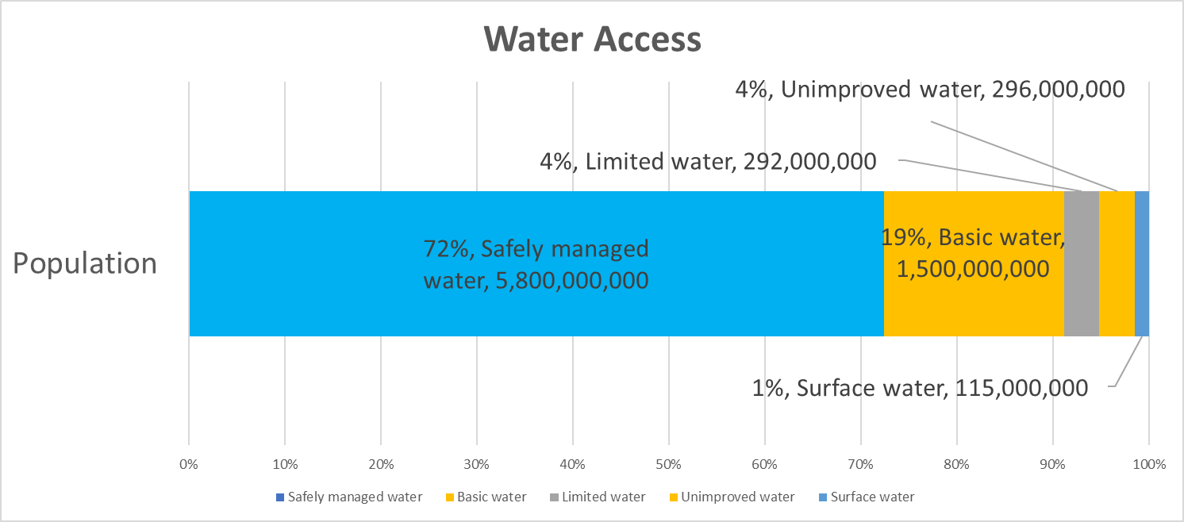
Prerequisite Background
Healthy Water
Tasty Water
Drinking water
Undrinkable Water
Alkaline ionized water is the only drinking water which is approved as medical effect in some countries !
Mineral water being one of the choices enlarges steadily the demand more than 10% or more every year.
2.2 billion people don’t have access to clean drinking water and 115 million people are drinking untreated surface water from lake, river, canal etc. (2022, UNICEF)

Slide 4
Why alkaline ionized water ?
・Compared to tap water, alkaline ionized water has a higher content of hydroxide ion and cations such as calcium, magnesium etc.
・Alkaline ionized water is the only drinking water which is approved as medical effect in some countries.
・Drinking of alkaline ionized water has been verified to be effective for improving weak gastrointestinal symptoms.
・Effectiveness of other symptoms are being expected and studies now.
？
Diabetes
Improvement of body condition
Immune
Osteoporosis
Alkaline ionized water
Atopy
Bronchial asthma
High blood pressure
Aging
Gastrointestinal symptom (verified)
Health

Slide 5
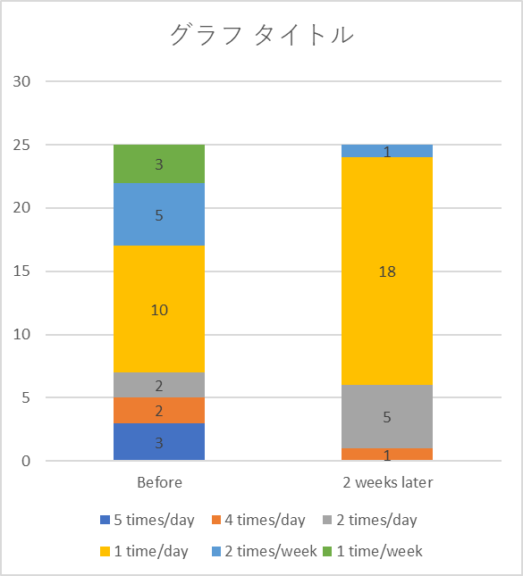
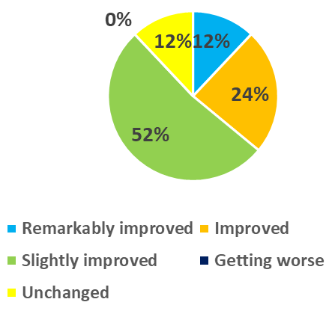
Effect of Alkaline ionized water
Frequency of feces
Health condition
Inspection item：
Blood test,
urinalysis,
examination of feces
88% of subjects felt their health condition got improved.
None of them felt it got worsen.
Examination method：
1,000 ml/of alkaline water of pH 9.5 per day
(400 ml in the morning and balance are at an optional time),
Two weeks drinking
Before 2 weeks later

Slide 6
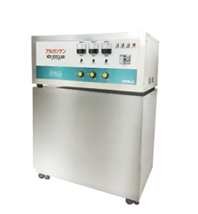
What is ionized water generator ?
In Japan, ionized water generators are classified as medical devices and must be approved by Ministry of Health, Labour and Welfare based on Japanese pharmaceutical law.
An ionized water generator has an electrolytic cell, and creates the water with pH 8-10 by the electrolytic reaction at the cathode thereof.
Pool tank
Example of NDX-3000LMW
Line pump
Stop Valve
Decompression valve
In case of lower source water flow/pressure
drain
Acidic water

Slide 7
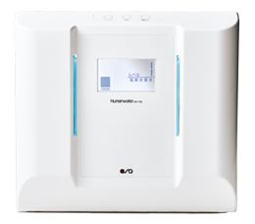
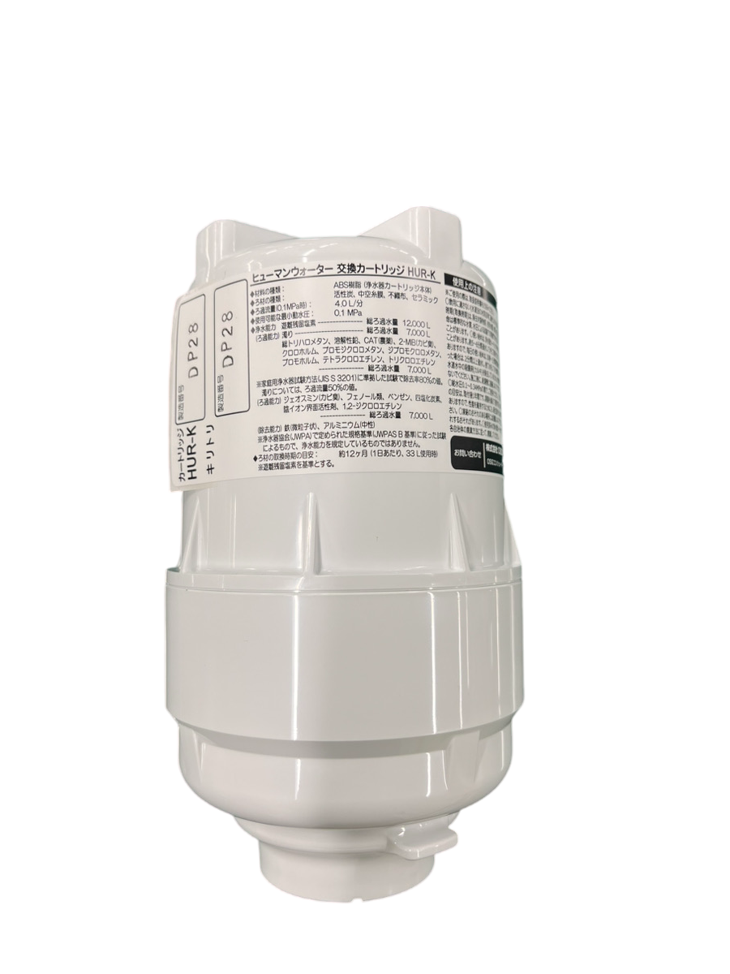
Products (Residential)①
Water Supply Specifications : 3 types
(alkaline ionized water/acidic ionized water/purified water)
Ionized alkaline water : 3 stages (pH8.5, pH9, pH9.5) with a margin pH+/- 0.5
Filtration flow rate (at 0.1MPa) : 4.0L / min
Flood water amount : Ionized alkaline water: Approximately 3.2 L / min,
Acidic water: Approximately 0.8 L / min
* When purifying water: Approximately 3.2 L / min
(water discharged from the switching cock)
Lifetime of electrolytic cell : 1,500 hours
Water purification Capacity : Free residual chlorine, Turbidity, Soluble lead,
CAT(pesticide), 2-MIB (moldy odor), Total trihalomethane,
Chloroform, Bromodichloromethane, Bromoform,
Dibromochloromethane, Tetrachlorethylene,
Trichlorethylene
Estimated time to replace filter : About 12 months (based on free residual chlorine)
for using about 33L per day
Human Water
HU-150
Cartridge filter
HUR-K

Slide 8
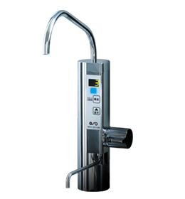
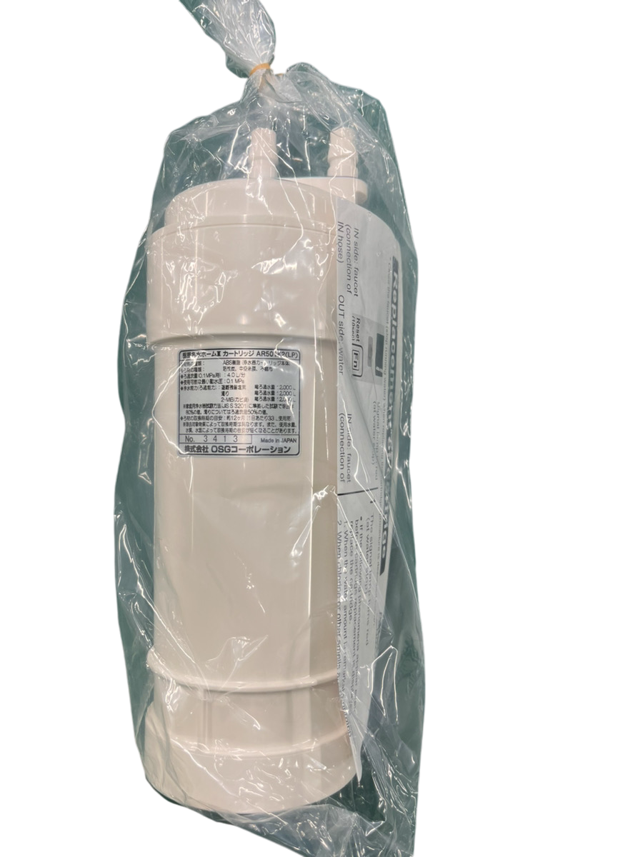
Products (Residential)②
Water Supply Specifications : 3 types
(alkaline ionized water/acidic ionized water/purified water)
Ionized alkaline water : 3 stages (pH8.5, pH9, pH9.5) with a margin pH+/- 0.5
Filtration flow rate (at 0.1MPa) : 4.0L / min
Flood water amount : Ionized alkaline water: Approximately 3.2 L / min,
Acidic water: Approximately 0.8 L / min
* When purifying water: Approximately 3.2 L / min
(water discharged from the switching cock)
Lifetime of electrolytic cell : 1,200 hours
Water purification Capacity : Free residual chlorine, Turbidity, Soluble lead,
CAT(pesticide), 2-MIB (moldy odor), Total trihalomethane,
Chloroform, Bromodichloromethane, Bromoform,
Dibromochloromethane, Tetrachlorethylene,
Trichlorethylene
Estimated time to replace filter : About 12 months (based on free residual chlorine)
for using about 33L per day
Alkali
NDX-501LM
Cartridge filter
AR501K2

Slide 9
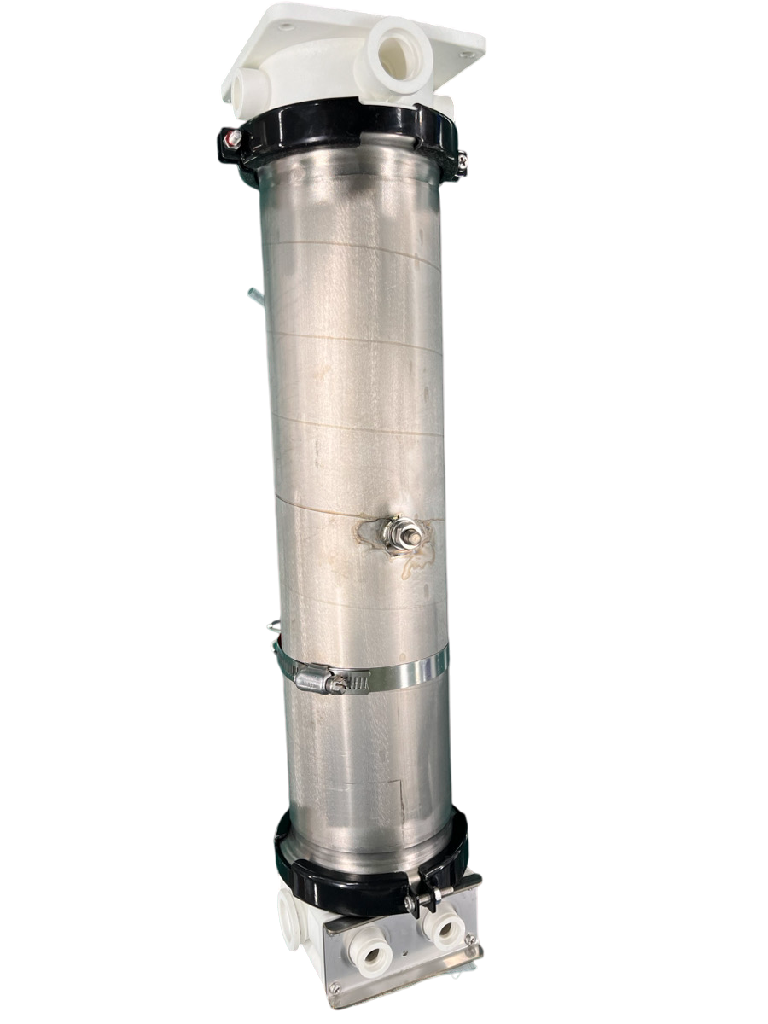
Products (Industrial)③
Water Specifications : 2 types (alkaline ionized water/acidic ionized water)
pH : Alkaline pH7.0~10.0 / Acidic pH7.0~4.0 *depending on water quality
Water discharge amount : Alkaline ionized water 3,000L / hour
(0.25~0.30MPa) Acid ionized water 1,500L / hour
Continuous production hour : 23hours (69,000L)
138,000 bottles x 500ml bottle per day
Electrolysis capacity : pH adjustment 5 stages
Electrode material : Titanium (platinum group surface treatment)
both anode(+) & cathode(-)
Feature :
① F.F (Flip-flop) method
Different from conventional products, 3000LMW can generate alkaline water
continuously by improvement of own valve and development of electrode material,
allowing change of the polarity of the electrodes at a regular intervals to prevent
of adhesion of calcium in the electrolytic cell.
② No daily chemical cleaning required
③ Improvement of durability of electrolysis against adhesion of scale activated by
electrolyzing
NDX-3000LMW
F.F Electrolytic cell
Assembly

